Slide 1
Representing webdata: XML
B. Prabavathy

Slide 2
What is XML?
XML stands for eXtensible Markup Language.
XML is a markup language much like a HTML.
XML was designed to carry data, not to display data.
XML tags are not predefined. We must define our own tags.
XML is designed to be self-descriptive.
XML is a W3C Recommendation.

Slide 3
XML Vs. HTML
XML and HTML is designed with different goals
XML was designed to transport and store data, with focus on what data is.
HTML was designed to display data, with focus on how data looks.
HTML is about displaying information, while XML is about carrying information.

Slide 4
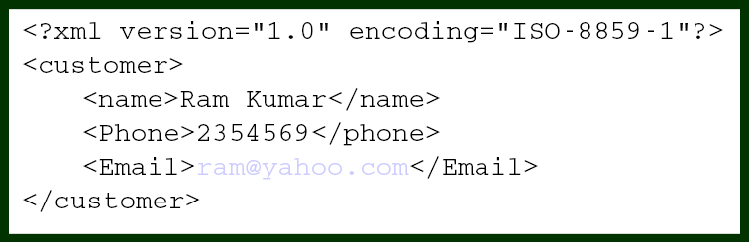
XML – Just tags?
XML is a combination of tags and content in which the tags add meaning to the content.

Slide 5
The XML Advantage
XML files are human-readable unlike binary data formats.
Widespread industry support exists for XML.
Major relational databases now have the native capability to read and generate XML data.
A large family of XML support technologies is available for interpretation and transformation of XML data for Web page display.
No display is assumed. Unlike HTML, XML makes no
assumptions about how tags will be rendered in a browser.
There is no built-in data typing. DTDs and XML Schema
provides these support.

Slide 6
Naming Rules
Names can contain only letters, digits and some other special characters
Names cannot start with number or punctuation marks
Names must contain the string “xml”, “XML” or “Xml”
Names cannot contain white spaces

Slide 7
XML – Syntax Rules
All XML Elements Must Have a Closing Tag
XML Tags are Case Sensitive
XML Elements Must be Properly Nested
XML Documents Must Have a Root Element
XML Attribute Values Must be Quoted
Entity References
XML document is said to be well formed if it confirms to the XML syntax rules

Slide 8
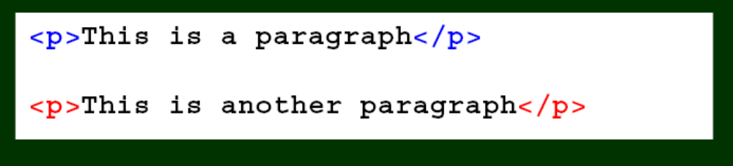
1. Closing tag
In XML, it is illegal to omit the closing tag. All elements must have a closing tag

Slide 9
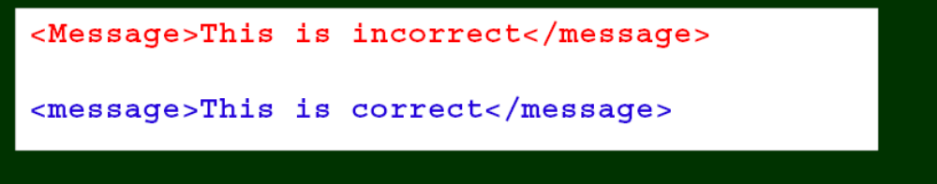
2. Case Sensitive
XML tags are case sensitive. With XML, the tag <Letter> is different from the tag <letter>
Opening and closing tags must be written with the same case:

Slide 10
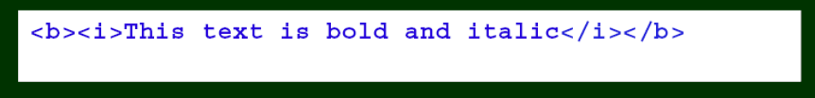
3. Properly Nested
In XML, all elements must be properly nested within each other

Slide 11
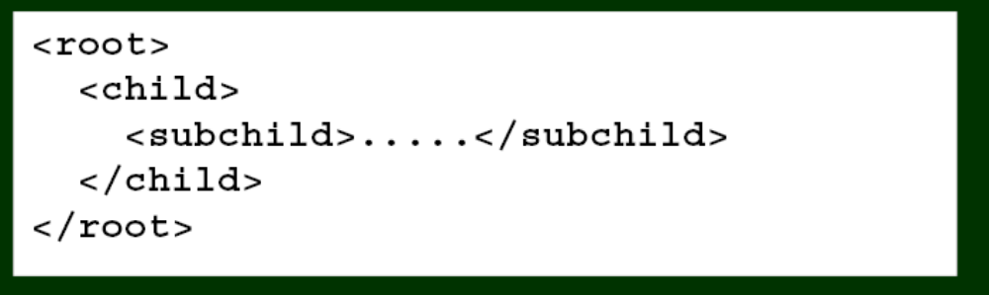
4. Root element
XML documents must contain one element that is the parent of all other elements. This element is called the root element.

Slide 12
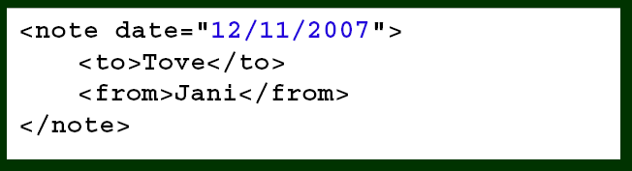
5. Attribute
Attribute values “Quoted”
• In XML the attribute value must always be quoted.

Slide 13
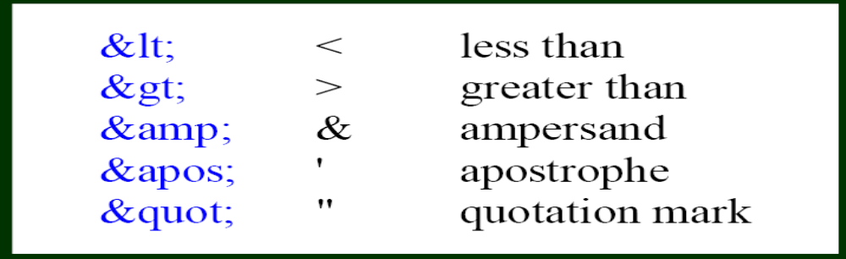
6. Entity Reference
This will generate an XML error:
<message>if salary < 1000 then</message>
To avoid this error, replace the "<" character with an entity reference:
<message>if salary &lt; 1000 then</message>
There are 5 predefined entity references in XML

Slide 14
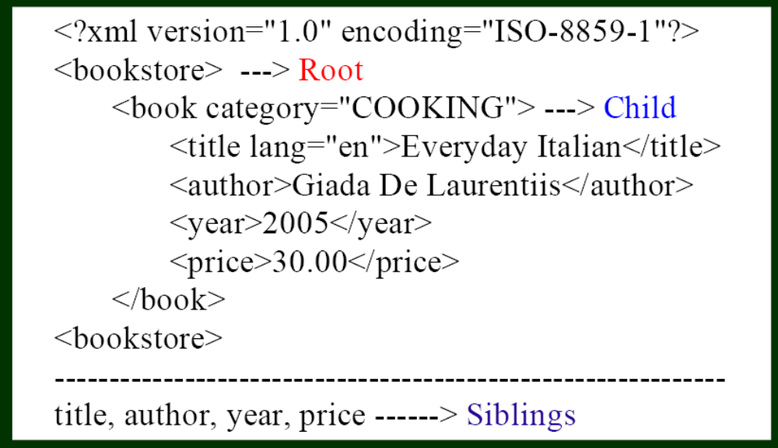
XML Tree
The first line is the XML declaration. It defines the XML version (1.0) and the encoding used.

Slide 15
Elements/Attributes
No rigid rule that decide when to use elements/attributes.
It is recommended not to use attributes for the following reasons
  It cannot contain multiple values
  Cannot be easily extendible
  Cannot represent logical structure
  Not easy to check against DTD
  Too many attributes reduce the readability of XML document

Slide 16
Namespace
XML document is developed to be used by many applications
Element and attributes are selected by developers
Name conflicts may occur when more than one XML documents are merged

Slide 17
…contd
Client.xml
<table>
<tr><td>HTML</td>><td>CSS</td><td>Javascript</td></tr>
</table>
Server.xml
<table>
<row><col>Servlet</col><col>JSP</col><col>PHP</col></tr>
</table>

Slide 18
Merging client.xml & server.xml
<technology>
<table> <tr><td>HTML</td>><td>CSS</td><td>Javascript</td></tr>
</table>
<table> <row><col>Servlet</col><col>JSP</col><col>PHP</col></tr>
</table>
</technology>
Two elements have different content and meaning
Querying a parser for the server side technologies fails

Slide 19
Solution
XML namespace provides a flexible solution to distinguish between element names in the XML document
It suggests to use prefix, Server uses prefix “s”
Client uses prefix “c”
<c:table>
<c:tr>
<c:td>javascript</c:td>
<c:td>vbscript</c:td>
</c:tr>
</c:table>
Who guarantees that the prefixes used by different developer will be unique?

Slide 20
…contd
Developers can use their own URL as prefix to every element they use
<{http://it.site.justl.ac/client}table>
<{http://it.site.justl.ac/client}tr>
<{http://it.site.justl.ac/client}td>javascript</{http://it.site.justl.ac/client}td>
<{http://it.site.justl.ac/client}td>vbscript</{http://it.site.justl.ac/client}td>
</{http://it.site.justl.ac/client}tr>
</{http://it.site.justl.ac/client}table>

Slide 21
Binding
How to make an association with prefix and the URL?
It is done in the starting tag using reserved attribute xmlns.
<c:table xmlns c:“http://it.site.justl.ac/client">
<c:tr>
<c:td>javascript</c:td>
<c:td>vbscript</c:td>
</c:tr>
</c:table>

Slide 22
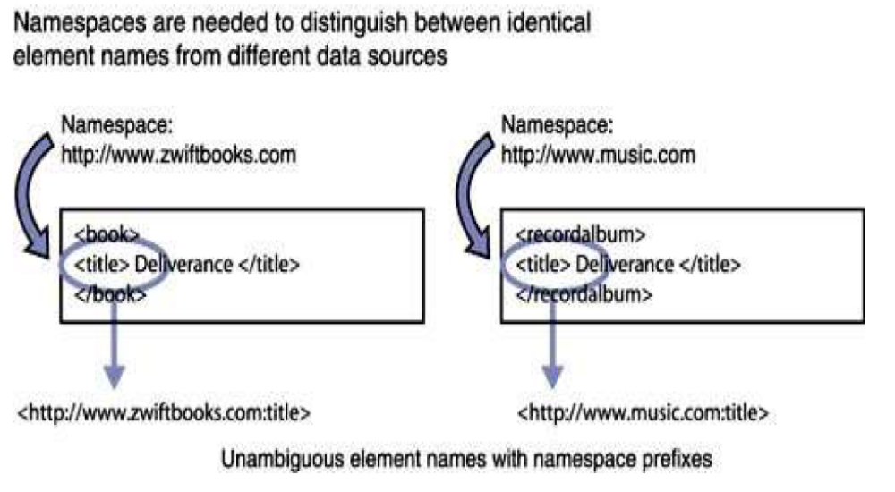
Example 1

Slide 23
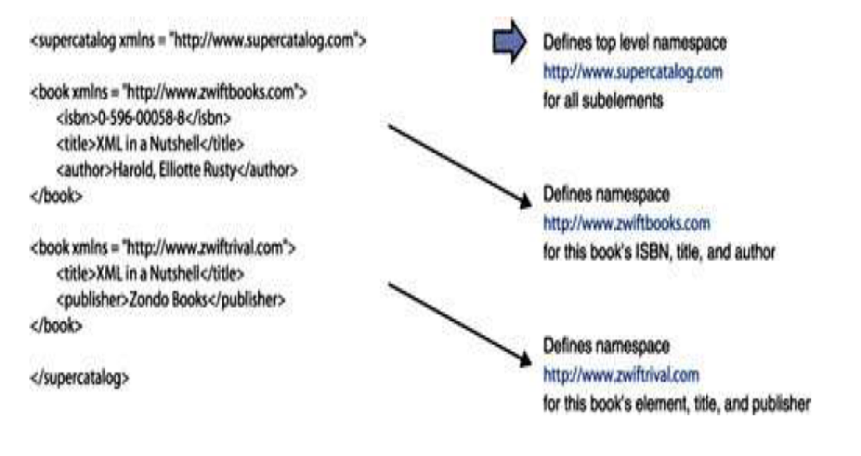
Example 2

Slide 24
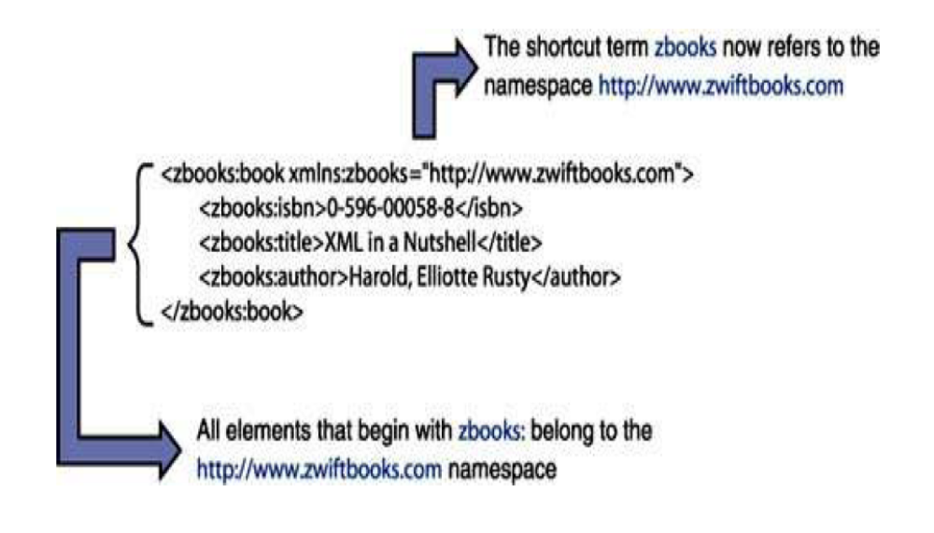
Example 3

Slide 25
Namespace rules
Namespace for the element is defined
All the descendent elements inherits the same namespace and associated prefix is used
Common practice is to define the namespace in the root of the element
Namespace defined explicitly in an element overrides the namespace obtained from its parent

